Slide 1
Absenteeism at work
Team Mercury
Netflix Data Science Bootcamp-Project 3
Members: Charne Jewell-Hart, Debora Rogers, Fana Wachamo, Amon Thomas
Date:5/3/2021

Slide 2
Objective
The objective of this project was to use a machine learning algorithm of our choice to optimize a test-train split for our desired dataset. For the dataset we chose, we wanted the algorithm to analyze a list of employee’s information and predict whether or not any features are directly correlated to the amount of hours the employee misses from work.

Slide 3
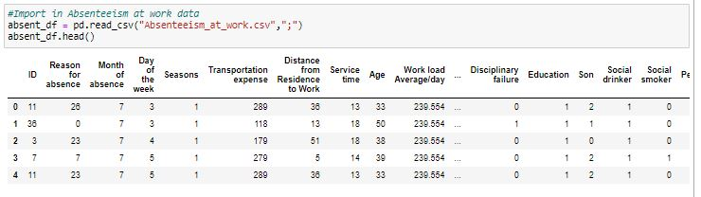
Loading in the Dataset

Slide 4
Assumption
When initially analyzing the the dataset we assumed that features like day of the week, social drinker, son, transportation expense,and Distance from residence to work would have a significant effect on hours of absenteeism at work.
Notes:
After feeding the dataset into our models and do multiple testings, we realized that our assumption was not accurate.

Slide 5
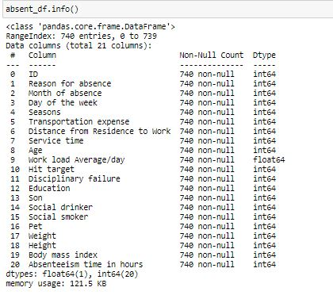
Overview of Dataset
Notes:
Talk about some of the columns(What they mean) we evaluated the columns to ensure they are all numerical prior to creating the model

Slide 6
Models
Linear Regression
Random Forest
builds, is an ensemble of decision trees, usually trained with the “bagging” method.
Principal Component Analysis (PCA)
used for dimensionality reduction by projecting each data point onto only the first few principal components
Notes:
In this projects we attempted to optimize our algorithm with the following models: Random Forest, Principal Component Analysis (PCA), and Ten Fold Cross Validation. We chose these models because they provide us the ability to use VIF values and the correlation matrix to try and filter out the data that was correlated and then focus on it. It also enables us try and filter out the data to get better prediction and score.
In the first attempt of the model we included all of the columns in our “X” value (dependent variables) and the “y” value was our Absenteeism in hours(independent variable)

Slide 7
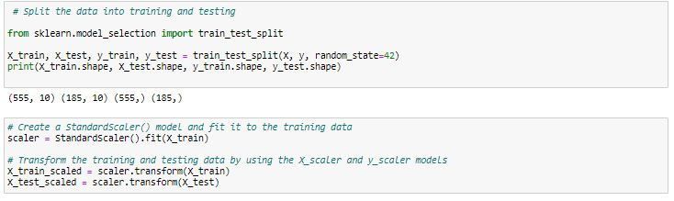
Splitting and Scaling

Slide 8

Fitting
Fitting the test and train values to a decision tree model

Slide 9

Testing and Training Score

Slide 10
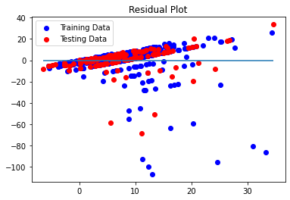
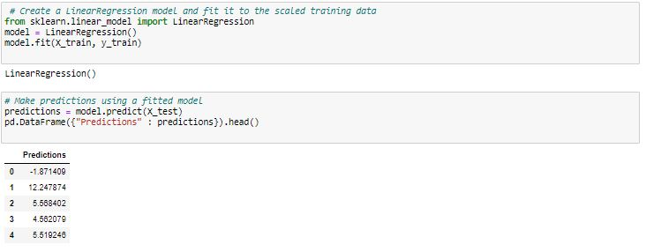
Linear Regression Model
Notes:
Underfit
Means additional data may need to be added or noise may be need be removed
Plots the difference between the model predicted values versus the model predicted

Slide 11

Random Forest model
precision recall f1-score support
0 1.00 1.00 1.00 10
1 0.33 0.32 0.33 28
2 0.43 0.50 0.46 42
3 0.35 0.35 0.35 31
4 0.37 0.41 0.39 17
5 0.00 0.00 0.00 1
8 0.66 0.67 0.66 72
16 0.00 0.00 0.00 9
24 0.00 0.00 0.00 4
32 0.00 0.00 0.00 1
40 1.00 0.33 0.50 3
64 0.00 0.00 0.00 1
80 0.00 0.00 0.00 1
112 0.00 0.00 0.00 1
120 0.00 0.00 0.00 1
accuracy 0.48 222
macro avg 0.28 0.24 0.25 222
weighted avg 0.47 0.48 0.47 222
RandomForest Modet Fit and Accuracy
Accuracy Score = 0.48
Notes:
We ended up with a training score of 96.28 but a test score of 51.35 using the classifier.

Slide 12
Variation Inflation Factor(VIF)
We also used the Variance Inflation Factor values to try and identify correlation between the features in the data set. We dropped any columns with a VIF above 5 and kept values less than 5. Values between 1-5 have a moderate correlation with values up to 10 being considered as strongly correlated. Higher values may explain the same variance which could be an indicator that one column should be dropped to improve the test score.

Slide 13
Variation Inflation Factors
Original VIF values
variables VIF
0 ID 8.178543
1 Reason for absence 9.689382
2 Month of absence 7.657510
Day of the week 9.365050
4 Seasons 8.710107
5 Transportation expense 21.912477
6 Distance from Residence to Work 13.124243
7 Service time 33.067876
8 Age 92.371416
9 Work load Average/day 60.215484
10 Hit target 864.935992
11 Disciplinary failure 1.617393
12 Education 8.303629
13 Son 2.591658
14 Social drinker 6.415011
15 Social smoker 1.373965
16 Pet 2.311560
17 Weight 6 76.859746
18 Height 1284.299262
19 Body mass index 606.166560
Notes:
Here we included the variance inflation factor values. On the left are the values prior to dropping any columns. The values after are on the right. Some of the values that showed some correlation here were Reason for absence, Day of the week, Month of absence, and seasons.

Slide 14
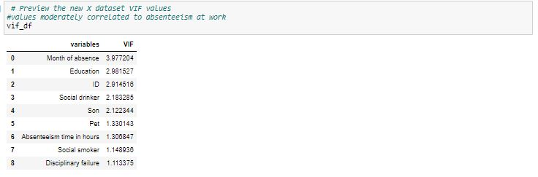
VIF values after dropping columns

Slide 15
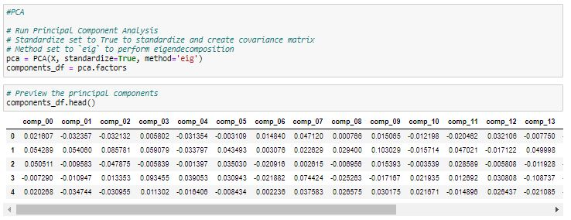
Principal Component Analysis

Slide 16
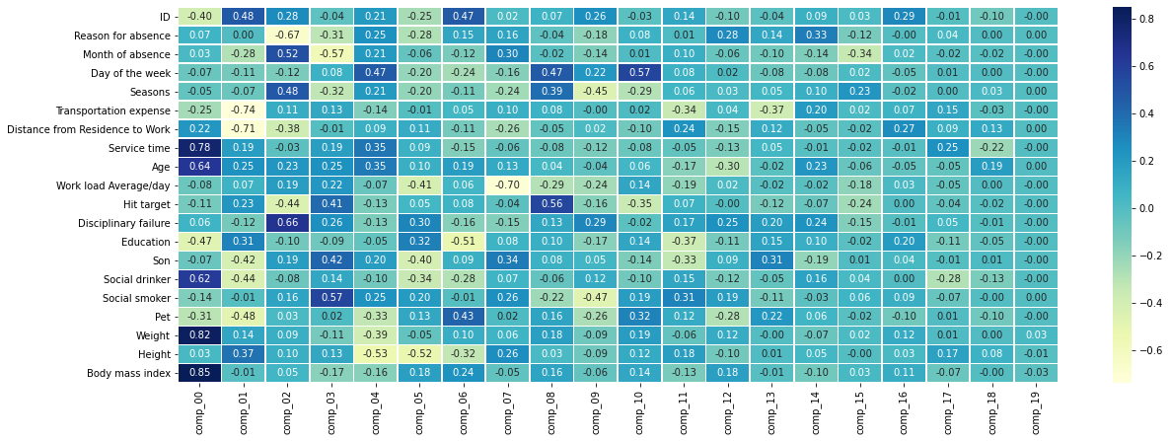
Correlation Matrix
Notes:
PCA(Principal Component Analysis)/Correlation Matrix
Used to reduce the dimensionality of the data set by transferring the large set of variables into smaller ones that still contain most of the information. We can determine from the matrix and the screen plot that we only need data from Comp 00-Comp 02 in order to capture the most information from the dataset. We saw correlation with: Age, Service time, Weight/BMI, and days of the week

Slide 17
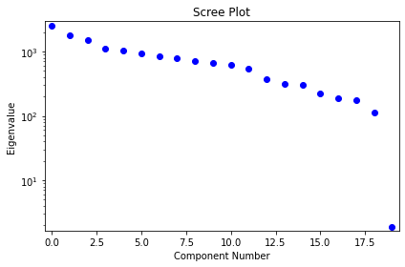
Scree Plot
Component 2
(comp_02)

Slide 18

10-Fold Cross Validation
Using 10-Fold cross validation we evaluated the model
Notes:
-The list of scores is the r^2 scores represent each
-The overall average score of 0.696015218067238
test set for the 10 fold validation
-K-10 Fold cross Validation randomly evaluates the partitions the model into equal samples to evaluate the predictive model. The values are processes 10 times and averaged for a final single estimation
Average score: 0.696015218067238
List if R2 scores ([0.74206042, 0.63910794, 0.56904301, 0.65749243, 0.74512726,
0.78981,0.65746426,

Slide 19
Implications
An average R2 value of .7 implies that about 70% of the variance in the model can be explained while the other 30% is unexplained. This can not be the only metric to size up your model .
The model fit moderately well to the sample in the plot; however, it did not perform well with the test set
The assertion can be made that adding more data and removing the noise from the dataset would give better results.
Notes:
With more optimization and filtering, improvements can be made to the test set to make model fit better

